Slide 1
Mycology

Slide 2
Objectives
20. Culture and identify the fungal species that cause dermatophytosis using one of the studied techniques.

Slide 3
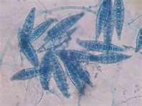
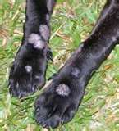
Mycology
Study of fungi and related diseases
Included Molds and yeast
Diseases of fungi are called mycoses
Superficial mycoses are called dermatophytes

Slide 4
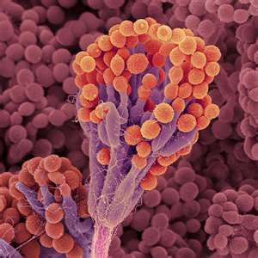
Molds vs. Yeasts
Molds:
Multicellular
Composed mainly of cellulose
Contain no chlorophyll
Must have oxygen
Wide pH range
Wide temperature range
Heat above 200 F will destroy spores
Reproduction by spores

Slide 5
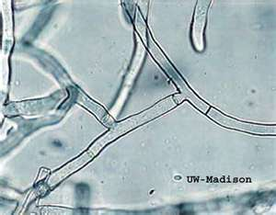
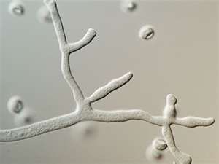
Molds vs. Yeasts
Molds:
Structures:
Hyphae
Filaments that reach out and grow towards food sources
Digest their food externally, through the release of digestive enzymes and then bring the resulting small molecules into the hyphae
Can be septate (segmented) or aseptate (unsegmented)

Slide 6
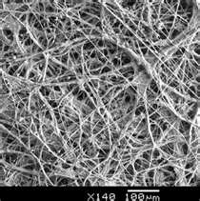
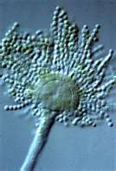
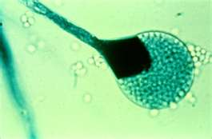
Molds vs. Yeasts
Molds:
Structures:
Mycelium
Mass of hyphae
Condidiospores
Spores that form at the end of hyphae
Sporangiospores
Spore sacs at the end of hyphae
Have a “flower” look

Slide 7
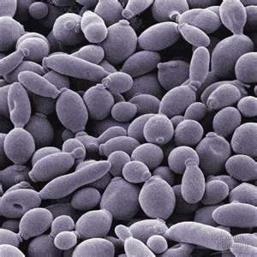
Molds vs. Yeasts
Yeasts:
Unicellular
Shaped like ovals or bowling pins
May be aerobic or anaerobic
Need moisture/humidity
Temperature range of 72 – 104 F, but body temperature is optimal
Reproduce through fission
Parent cell divides into daughter cells

Slide 8
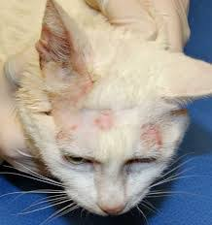
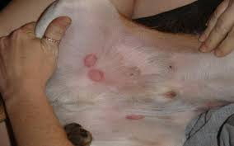
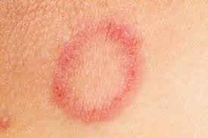
Agents of Importance

Slide 9
Microsporum & Trichophyton
“Ringworm”
Extremely hardy and can live in the environment for years
All it takes is direct contact with an asymptomatic carrier, symptomatic carrier or contact with the spores in the environment
Zoonotic
Bleach 1:10 solution will kill 80%
Dermatophytes fungi feed upon the dead cells of skin and hair causing a classic red lesion with a ring od scale around the edges and normal recovering skin in the center.
In animals the lesion often looks dry, grey scaly patch but can mimic other skin lesions and have any appearance

Slide 10
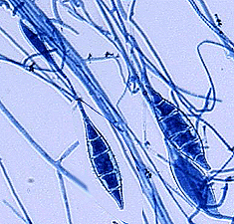
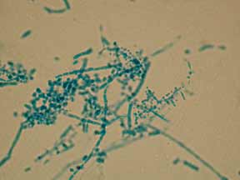
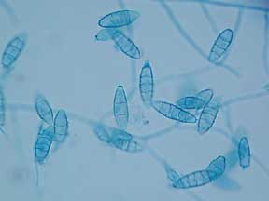
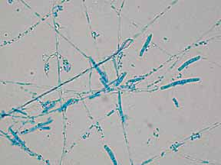
Microsporum & Trichophyton
M. canis
T. equinum
M. gypseum
T. mentagrophytes

Slide 11
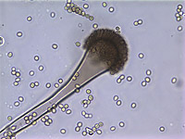
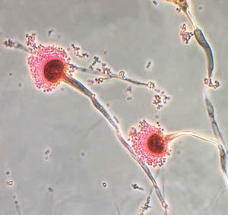
Aspergillus
Ecology
Commonly found growing on dead leaves, stored grain, compost piles, or in other decaying vegetation.
Common on food products that have been kept to long
Normal immune system prevent infection by sneezing, mucus linings and immune system
Causes
Nasal
Sino nasal is the most common manifestation of Aspergillus.
Can break down soft bone of the sinuses
Disseminated
Systemic or widespread
Many organ affected, especially the lungs, CNS and GI

Slide 12
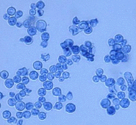
Blastomyces
Natural locations
Ecology
Slightly acidic soils and wood
From the Mississippi River to the Atlantic
River Valleys
Causes
“Blastomycosis”
Systemic infection
Can affect the lungs, eyes, bones, skin, lymph nodes, SQ tissue, brain and testis

Slide 13
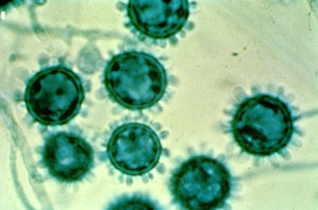
Histoplasma
“Histoplasmosis”
Ecology
Found in the soil along all major river valleys
Humid environments with highly nitrogenous soils, especially those contaminated with bat feces
Bat cave exploration
Tiny, oval, fungi with narrow bases
Clinical Signs
Vary and are nonspecific
Systemic, pulmonary and GI infections

Slide 14
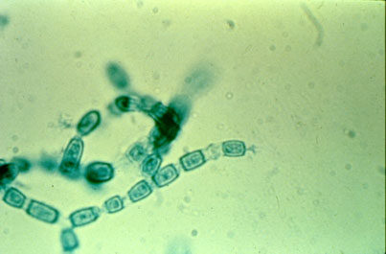
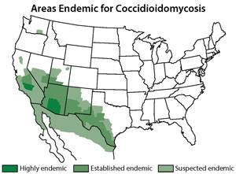
Coccidioides
“Valley fever”
Ecology
Alkaline desert soil with high levels of salt and carbonized organic material
Double retractile cells
The condition is caused by inhaling dust or dirt contaminated with a fungus of the Coccidiodes genus.
Causes
Low grade cough and calcification of local lymph nodes or if immunosuppressed can cause pneumonia

Slide 15
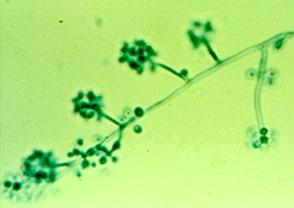
Sporothrix
Sporotrichosis”
Ecology
Common in soil, tree bark, and plants
Central and Northern US
Infection is through a wound (Rose Pickers Disease)
Causes
Lymphocutaneous-most common
Small, firm dermal to subcutaneous nodules
Cutaneous
Tends to remain localized to the site of inoculation
Disseminated
rare but potentially fatal Infection develops via tissue spread from the initial site of inoculation to the bone, lungs, liver, spleen, testes, GI tract, or CNS.
Zoonotic infections can occur

Slide 16
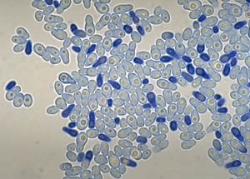
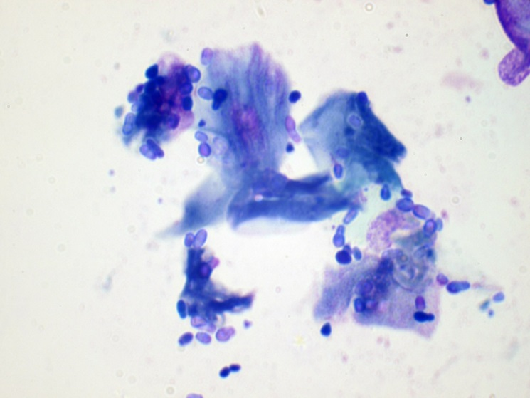
Malassezia pachydermis
Secondary cause of underlying issue
Allergies, narrowed ear canal, moist environment
Common yeast infection of superficial skin and external ear canal
Normally found in the ear but overgrowth can occur when the enlivenment of the ear canal changes
Clinical signs?
Cleaning of the ears?

Slide 17
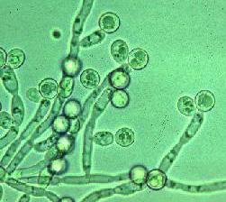
Candida Albicans
Candidiasis is a local mucocutaneous Dz of by a yeast-like fungi
Ecology
World-wide
Opportunistic fungus for oral and genital issues
Commonly found in the GI system
Clinical Signs
Infection of the mouth, crop and esophagus
Stomatitis and enteritis in puppies and kittens
Can overgrow after prolonged antibiotic therapy
Test for
Scrapings of lesions in LPCB or India ink stain

Slide 18
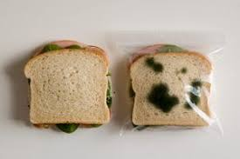
Testing

Slide 19
Ear Cytology Procedure
Materials
Q-tips
Glass microscope slide
Lighter or Bunsen burner
Diff –quick stains
Procedure
Obtain samples from both ears with q-tip
Roll gently on microscope slide
Heat fix slide
Jar 1- Fixative-Dip slide in the fixative 5 times for 1 second each dip. Tap slide on paper towel to remove excess.
Jar 2-Eosinophillic stain-Dip slide in the stain 5 times for 1 second each. Tap slide on paper towel to remove excess
Jar 3- Basophilic stain- Dip slide in the stain 7-10 times for 1 second each dip. Rinse in a GENTLE stream of water.
Air dry completely
Examine under 1000x with immersion oil - quantify x/HPF
**you may see aerobic bacteria & yeast!!!!

Slide 20
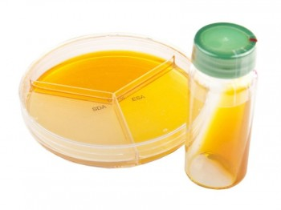
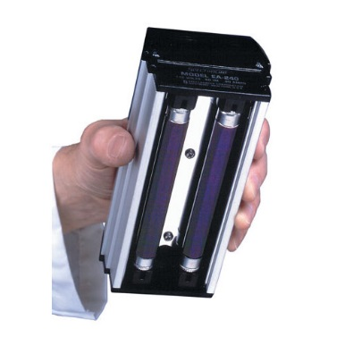
Supplies for Dermatophyte Testing
Forceps
Swabs
Lactophenol cotton blue stain (LPCB)
Potassium hydroxide solution (KOH)
Culture media (DTM and/or Sabouraud agar)
Wood lamp
Cellophane tape
Separate room and incubator – fungal spores may contaminate bacterial supplies

Slide 21
Dermatophyte Testing
Most dermatophytes will grow on the hair shaft and some can be visualized microscopically
Pluck a few hairs – periphery lesion
Place on a slide with 1 to 2 drops of 10% KOH
After 2 to 10 minutes small globular arthrospores attached to the shaft are visible and indicate a positive test result

Slide 22
Dermatophyte Testing (cont.)
Wood lamp
Ultraviolet light source
Warm up for 5 minutes before use
Results may be ambiguous
Only about 50% of cases
Must be at the right life stage
Hairs infected with some species of Microsporum are a apple-green in a darkened room using fluorescence

Slide 23
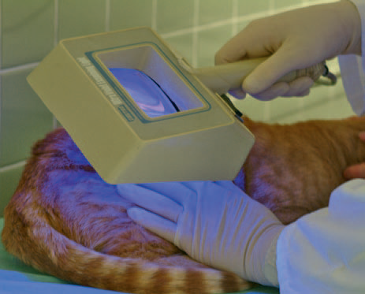
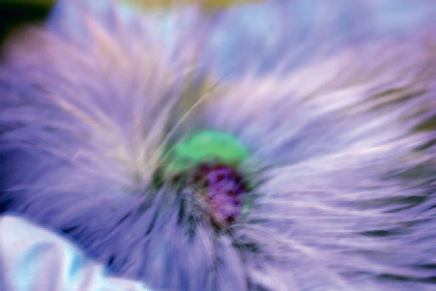
Dermatophyte Testing (cont.)

Slide 24
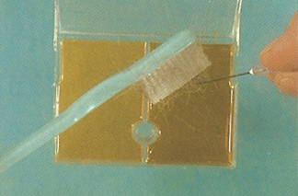
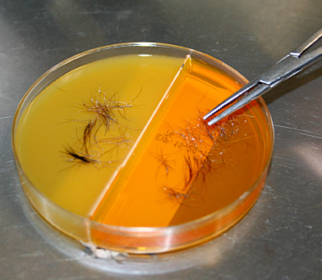
Inoculating Growth Media
Hairs and scales should be taken from the edge of a lesion
McKenzie Toothbrush Method
Any new toothbrush sealed in a package and use to “brush” the hair.
Pluck Method
Using hemostats gently pluck hair or scales from the animal
Gently press sample into the media
Inoculate with the lid or cover loose
At first sign of color change, perform a wet prep using Fungi-Tape or cellophane tape and lactophenol cotton blue stain
Evaluate daily for 21 days

Slide 25
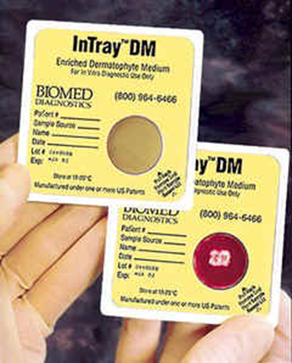
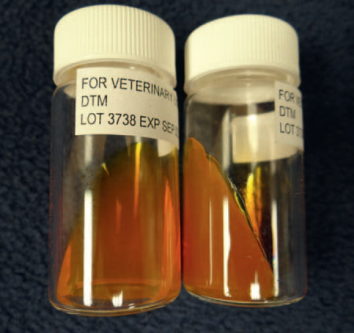
Dermatophyte Testing (cont.)
Several products available for culturing
Dermatophyte test medium (DTM)
Agar changes color during organism growth from orange to red.
Easily allows growth of Micosporum spp, Trichophyton spp.
Also allows growth of bacteria and yeast

Slide 26
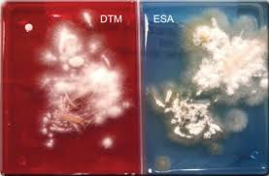
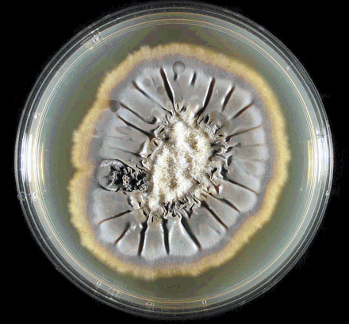
Dermatophyte Testing (cont.)
Enhanced sporulation medium (ESM)
Both have color indicators and can be used in conjunction with DTM to accelerate the formation of macroconidia used for identification and confirmation
Sabouraud dextrose agar
Also promotes early formation of macroconidia but no color indicator
Modified Sabouraud Agar (SDA)
Designed for identification of fungi based on their cultural characteristics
Inhibit bacteria growth
Note certain aspects of gross morphology
Rate, topography, texture, and pigmentation
Also note morphology during microscopic examination

Slide 27
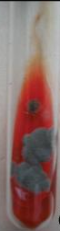
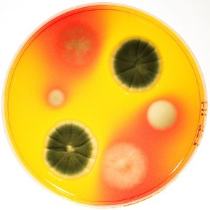
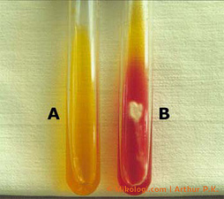
Interpreting DTMs
Organisms use the protein in the media for nutrition
This causes the pH to change producing a color change
Any organism can potentially produce a color change
It does not necessarily mean there is a dermatophyte
Dermatophytes grow white to off white
Pigmented growth is not a dermatophyte and should be ignored
Definitive diagnosis requires microscopic examination
Tape mount to remove the organism from the agar works best
Use a lactophenol cotton blue or new methylene blue stain

Slide 28
Fungal Cultures (cont.)
After incubation – any change check microscopically
2.5 inches of clear cellophane tape
Gently press the center of the tape, sticky side down, onto the center of the sample
Place tape sticky side down on slide that has a drop of lactophenol cotton blue on it
Observe under low power and high dry if needed

Slide 29
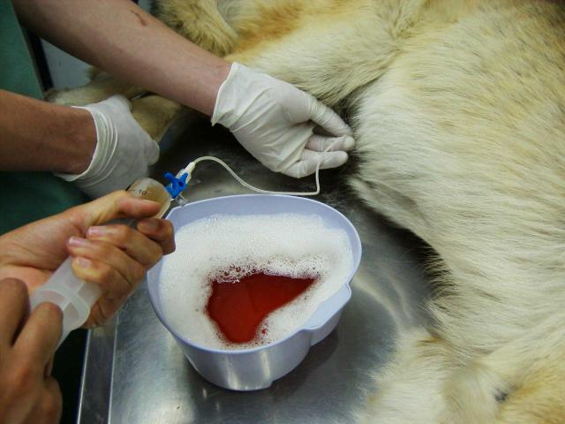
Mycology Collection Methods
Deep mycoses sampling
Internal sites such as:
Respiratory fluid
Blood
Bone marrow
Urine
Feces
Spinal fluid
Usually recovered through centesis or incision

Slide 30
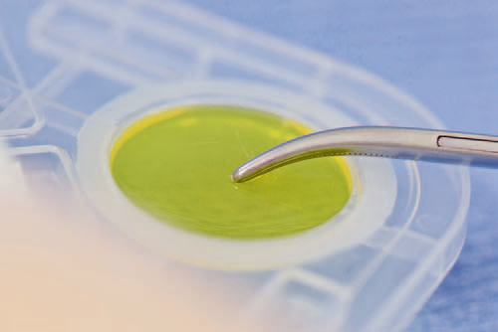
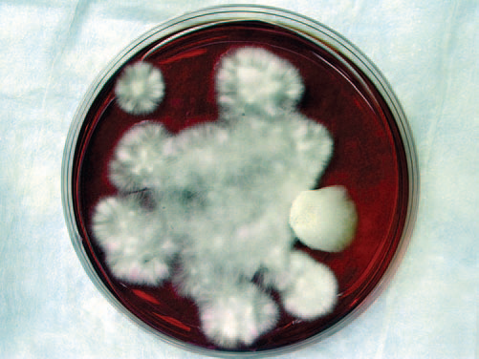
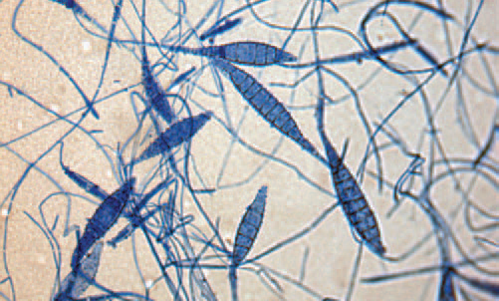
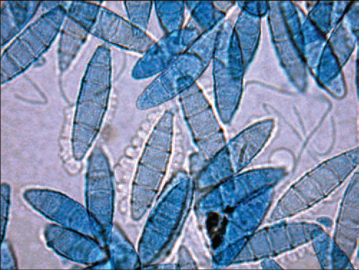

Slide 31
???
What stain is used to detect microsporum?
A. Gram’s
B. Lactophenol Cotton Blue
C. New methylene Blue
D. Dip Quick

Slide 32
???
What stain is used for ear exudate examination?
A. Gram’s
B. Lactophenol Cotton Blue
C. New methylene Blue
D. Dip Quick
E. A or D

Slide 33
???
What is the Scientific name for the budding yeast found in the external ear?

Slide 34
Objectives
20. Culture and identify the fungal species that cause dermatophytosis using one of the studied techniques.

